Slide 1
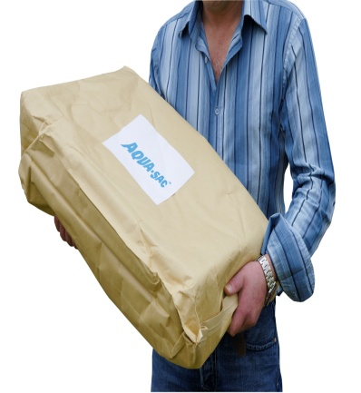
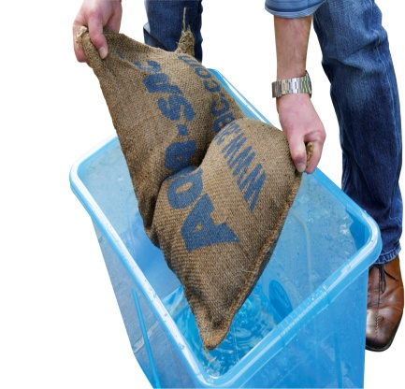
Easy to use!
Pack of 25 bags
Place in water in inflate in 5 mins
(Inflation tanks are provided for this purpose)
Build a wall to protect

Slide 2
Aqua-sac®
Procedure for building an Aqua-sac® wall and dams
An Aqua-sac ® when inflated is 10.5 cm high, 54 cm long and 31 cm wide.
Therefore building an Aqua-sac ® wall up to 63cm high by 93 cm deep and 1 metre long requires approximately 36 inflated Aqua-sac® s.o.s. bags
Note: Building a wall can be strenuous so it is very important that all those involved are fit enough to carry out this task.
To build an Aqua-sac ® wall identify firm and level ground, free from obstructions.
If the wall or dam is going to be in place for a long period of time PVC sheeting should be used to form a barrier on the wet side of the wall.
The area must be hosed down afterwards to prevent slipping hazards.

Slide 3
Aqua-sac®
There are two ways of laying sandbags - Headers and Stretchers).
Headers ( viewed from the top)
Stretchers ( viewed from the top)

Slide 4
Aqua-sac®
Headers should be used on first, third and fifth courses etc. Stretchers are used on second, fourth and sixth courses etc.
Layer 1
Layer 2
Layer 3
Wall or dam ( viewed from the top)

Slide 5
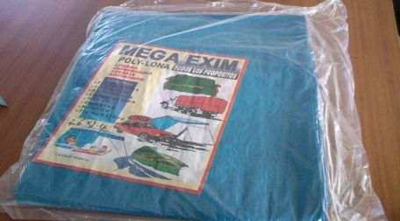
Aqua-sac®
Wall or dam with PVC barrier( viewed from the side)
Ground sheet

